Slide 1
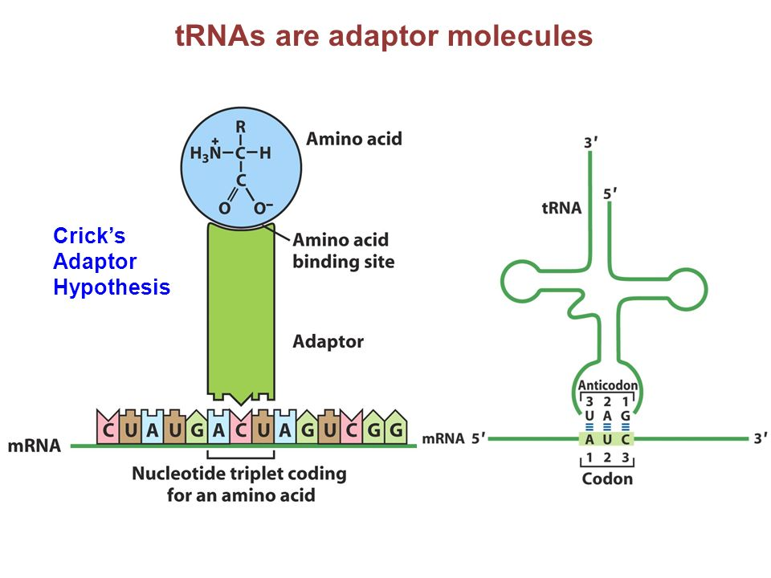
The mystery of genetic code
Lecture - 17

Slide 2
Overlapping vs nonoverlapping codes

Slide 3
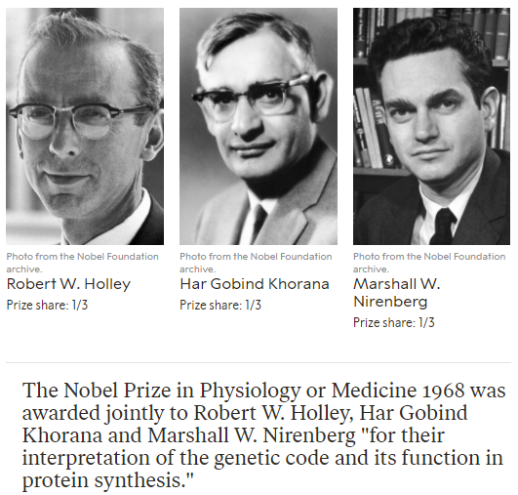

Slide 4
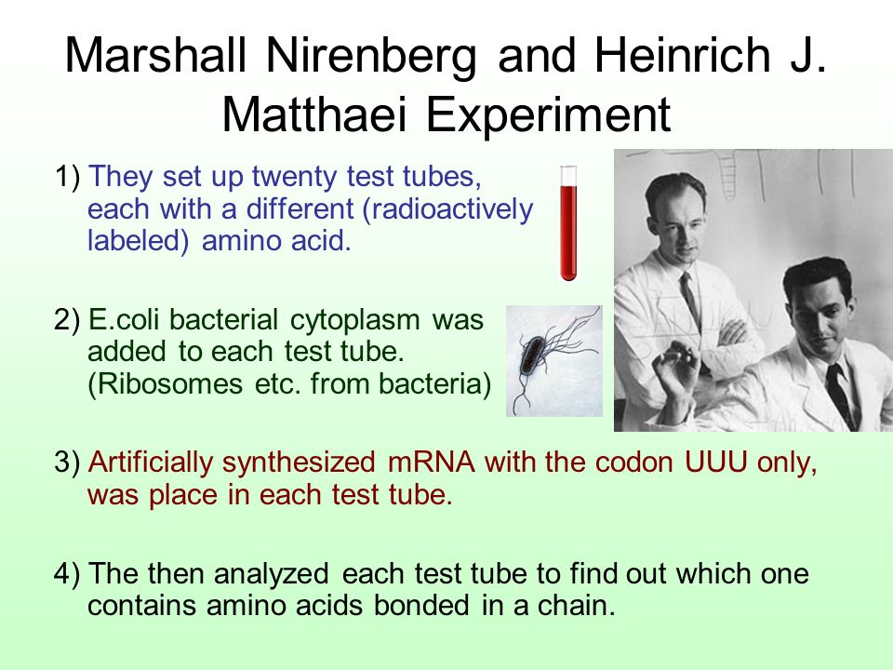

Slide 5
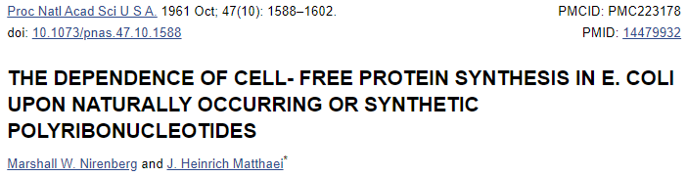
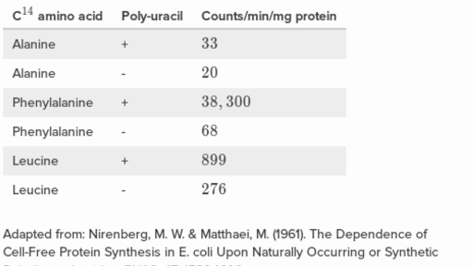
AAA – Lys
CCC - Pro

Slide 6
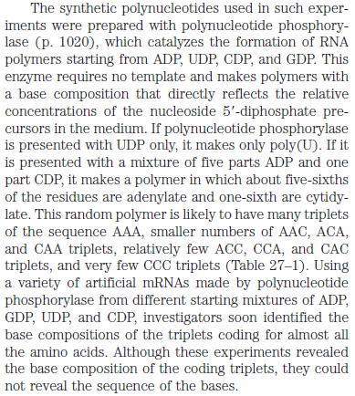
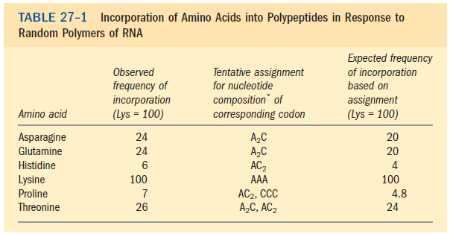

Slide 8
Basis of silent mutations

Slide 9
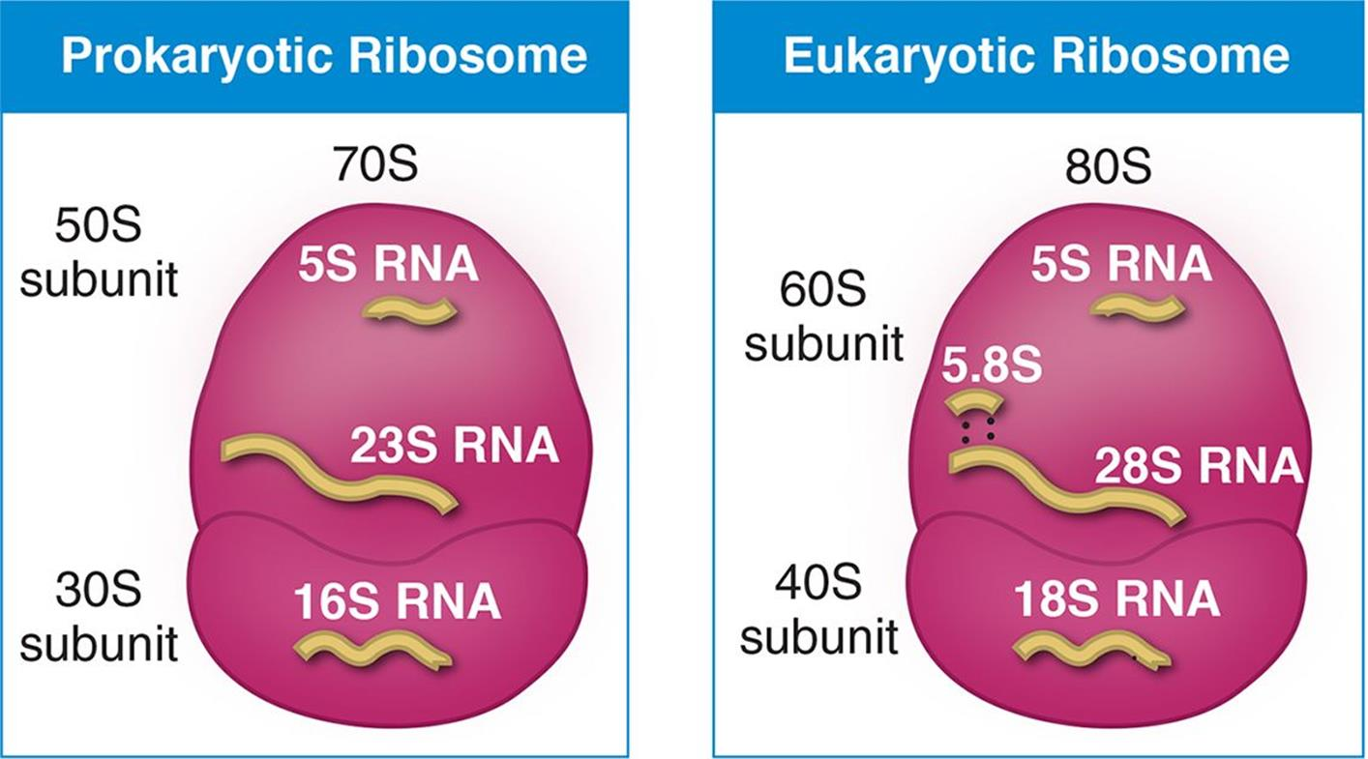
Ribosome, the protein translation machine

Slide 10
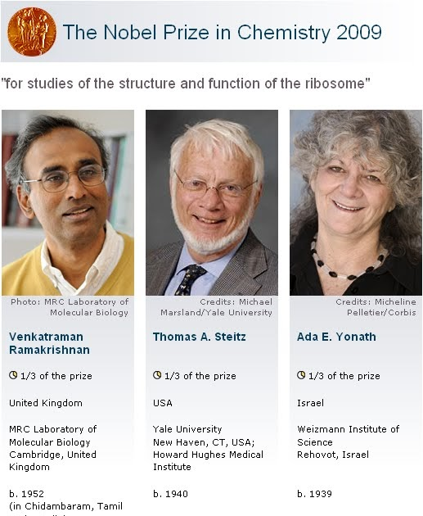

Slide 12
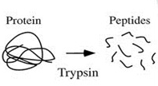
Direction of Chain Growth

Slide 13
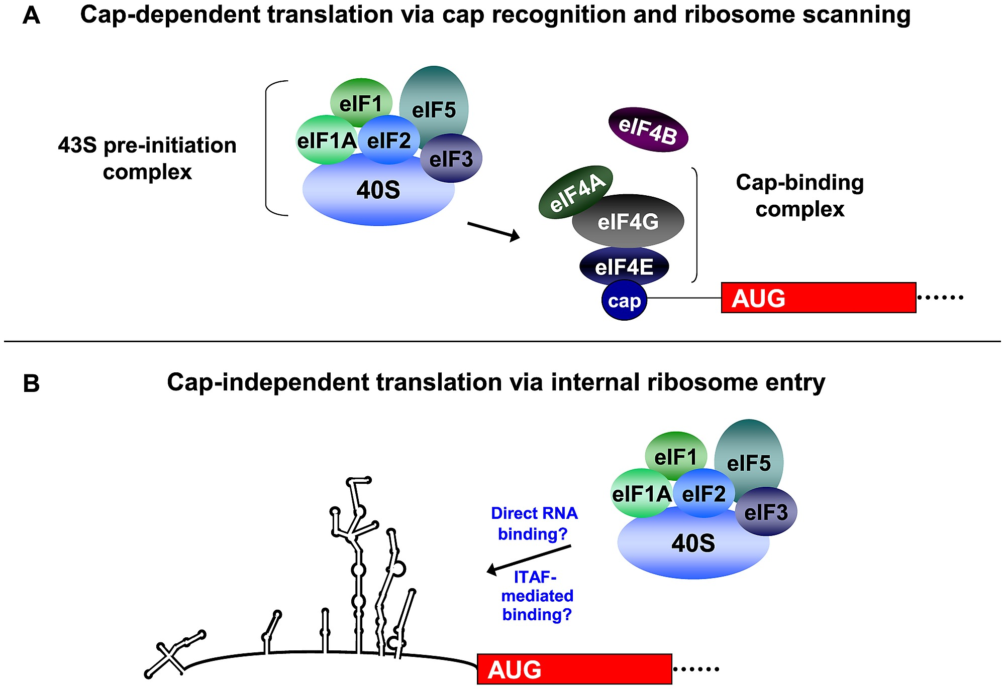

Slide 14
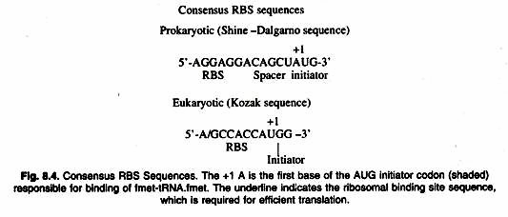
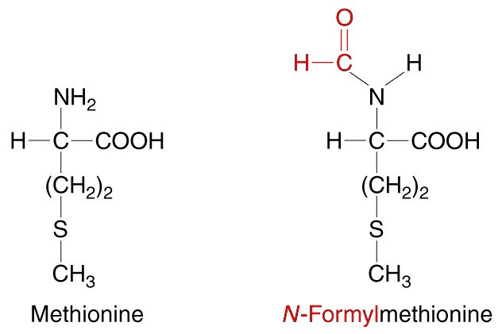
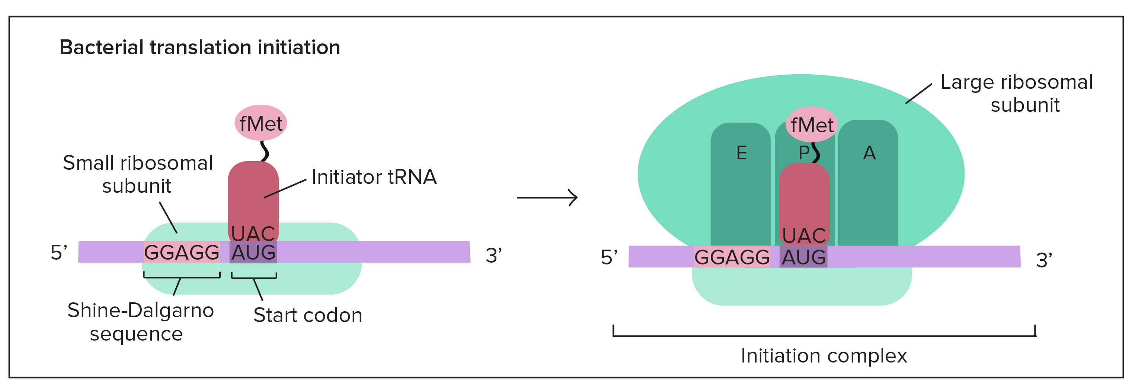
Ribosome binding site (RBS
Notes:
fMet plays a crucial part in the protein synthesis of bacteria, mitochondria and chloroplasts. It is not used in cytosolic protein synthesis of eukaryotes, where eukaryotic nuclear genes are translated. It is also not used by Archaea. In the human body, fMet is recognized by the immune system as foreign material, or as an alarm signal released by damaged cells, and stimulates the body to fight against potential infection.

Slide 15
Three tRNA binding sites in ribosome
Notes:
The P-site (for peptidyl) is the second binding site for tRNA in the ribosome. The other two sites are the A-site (aminoacyl), which is the first binding site in the ribosome, and the E-site (exit), the third. During protein translation, the P-site holds the tRNA which is linked to the growing polypeptide chain.

Slide 16
Translation termination
What next?
Folding
Post-translational modifications
Trafficking
Function

